Slide 1
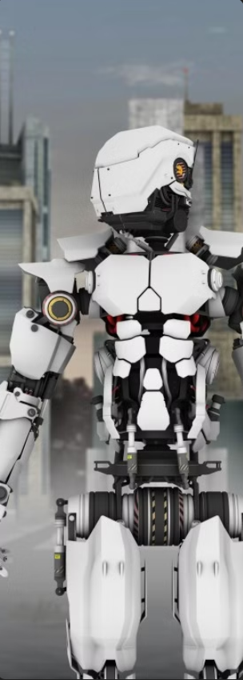
Decentralized Multi-Agent Pursuit Using Deep Reinforcement Learning by:Jaideep randhawa

Slide 2
Contents
Introduction
Problem
Methodology
Deep Reinforcement Learning
Experimental Set-up
Results
Contributions

Slide 3
Introduction
This research paper addresses Pursuit-Evasion problem where multiple agents/ pursuers capture a mobile target (Omnidirectional Target).
Some Basics :
Omnidirectional Target : Target that can move in any direction.
Multiple Homogeneous Agents
Unicycle Kinematic Constraints : Agents are restricted to make only standard non-holonomic movements i.e. they can either move forward, backward, turn left, right but cannot go sideways. This makes its real-world applications.

Slide 4
INTRODUCTION
In case of shared experience in training, experiences of different agents are stored in a common pool called Replay Buffer.
From the replay buffer , a shared policy is developed that incorporated the collective wisdom of all robots’ experiences.
Decentralized Behaviour : All agents work independently and avoid single point of behaviour.
Classical Algorithms : These assume omnidirectional pursuits and do not adapt to evader ‘s behaviour.
DRL for multi-agent pursuits: DRL approach is used for using local measurements and non-holonomic motion constraints.
This paper used DRL Approach to adapt the pursuer’s behaviour dynamically, allowing them to react to the unpredictable movements of an omnidirectional target.

Slide 5
problem
Multi-agent pursuit-evasion entails coordinated efforts by multiple agents to capture a single or multiple targets in a competitive environment.
Challenges :
Effective Coordination Without Centralized Control: Ensuring multiple agents can work together to capture the target without relying on a central command system.
Adhering to Realistic Motion Constraints: The pursuers must follow non-holonomic constraints meaning they cannot move sideways and must navigate and turn realistically.
Efficiently Training in Complex, Dynamic Environments: Developing robust strategies that allow agents to adapt and succeed in a variety of unpredictable and challenging scenarios.

Slide 6
METHodology
DRL Approach: Utilises Twin Delayed Deep Deterministic Policy Gradient ( TD3) to train a decentralised policy for multiple agents.
State Representation: It encapsulates relative positional information of neighbouring agents and the target.
Training Process: Employs curriculum learning and a reward structure , encouraging good formations and combining individual and group rewards.

Slide 7
Rewarding
During training, rewards are used to guide the learning process.
Individual Rewards: e.g. If a robot moves closer to the target
Group Rewards: e.g. If a group surrounds the target or captures it, all agents might receive a reward.
Experiences include States, Actions, Rewards and Next Stage.
Note: No real-time rewards – Once training is complete, agents no longer receive rewards during real time execution. They act based on the policy learned during training.

Slide 8
Deep reinforcement learning
Training Process:
Curriculum Training: Starts with simpler tasks and then increasing complexity. Helps agent to learn basic strategies.
Replay Buffer: Stores experiences (State, Action, Reward, Next State) of all agents. Shared experiences help in updating the policy more effectively.
Reward Mechanism: Majorly Two i.e. Individual and Group (Discussed Before).
Policy Training: Algo’s like TD3 are used to train the policy. Involves experiences from the replay buffer to optimize policy iteratively.
Note: During Execution, the agents use the learned policy independently, without real-time rewards ensuring robustness and scalable puruit strategies.

Slide 9
Experimental setup
Simulated Experiments: We compare the proposed method with other state-of-the-art approaches based upon the capture rate and the average time to capture.
Real world demonstration : We validate the trained policy with motion constrained pursuer drones.

Slide 10
results
Simulation Results: The proposed method outperforms classical and other DRL methods in terms of capture success rate and efficiency.
Real world validation : Successful Proof-of-Concept (POC) with real drones demonstrate the feasibility of sim-to-real (bridging from simulation to reality) transfer.

Slide 11
Contributions
Decentralized Approach
Non-Holonomic Constraints
Deep Reinforcement Learning
Notes:
Consider talking about:
Deep reinforcement learning
Inverse reinforcement learning
Apprenticeship learning

